Slide 1
DisCourse:
A flexible platform to talk about course selection
Team 14
Hazel Dunn, Nicole Pupp, Kimney Nguyen, Matthew Chandra, Seraphina Yong
Notes:
(10 sec)
Today we’ll be presenting the user research and ideation process for DisCourse, a flexible platform for talking about course selection.

Slide 2
Idea
Create a course-reviewing platform that fulfills student needs
Notes:
(~11-13 sec)
Our initial idea was to come up with platform for reviewing and sharing information about courses, after seeing how most related solutions are not really organized around courses.

Slide 3
Interview Process
We proceeded with the interview process after confirming user consent.
We interviewed 6 students, all undergraduate and graduate in different majors at the U of M. Each was asked the same set of questions.
Background questions: 5-10 mins
Usage/Experience Questions: 25-35 mins
Obtain Consent
Before starting the interview, we would familiarize the participants with the consent form that would let them know what are expected from them in this user study and what their rights are regarding how we proceed with the user study. We also made sure that they know the voluntary nature of the research and that they would not be compensated for participating in this study
Conclusion
Once the interview has ended, the participants were asked if there were any other points they would like to convey to us. For both students who were interviewed and who took the survey, we reminded them once more about their rights, reconfirmed their consent, and finally thanked them for their participation.
Survey
We performed a survey that we sent to additional 28 graduate and undergraduate students at the U of M. We first presented users with the consent form, then asked questions in both multiple choice and short answer style.
Background questions: ~5 questions
Usage/Experience Questions: ~10 questions
Notes:
kimney

Slide 4
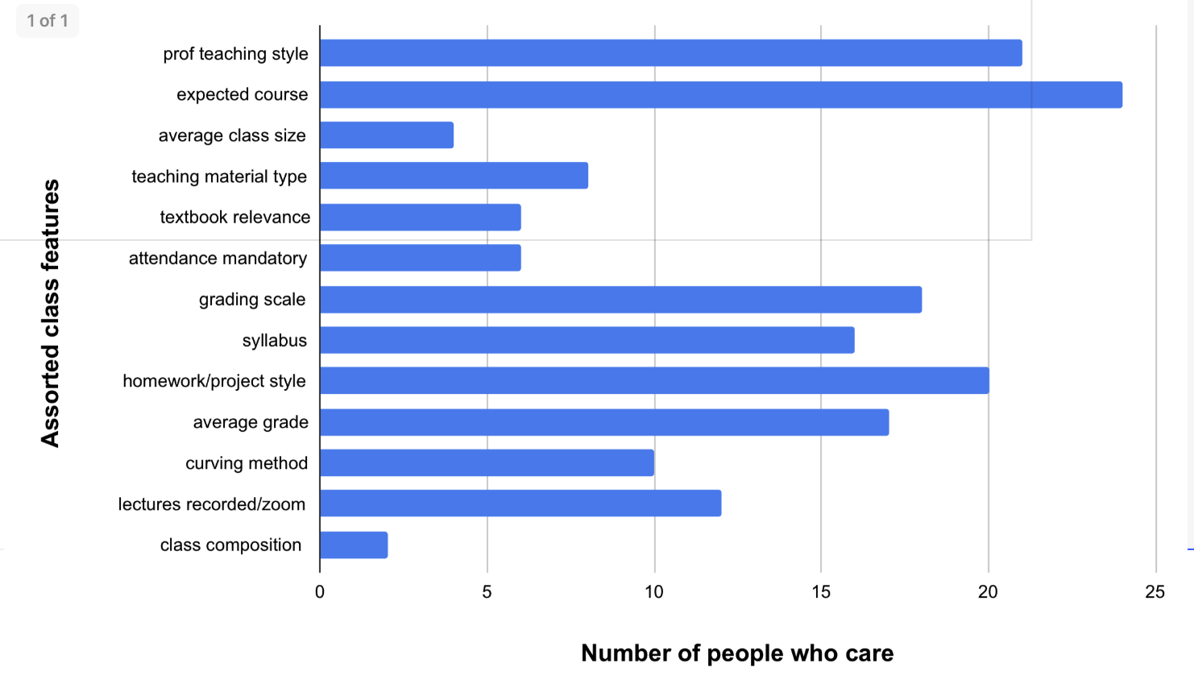
Survey Results
Top considerations

Slide 5
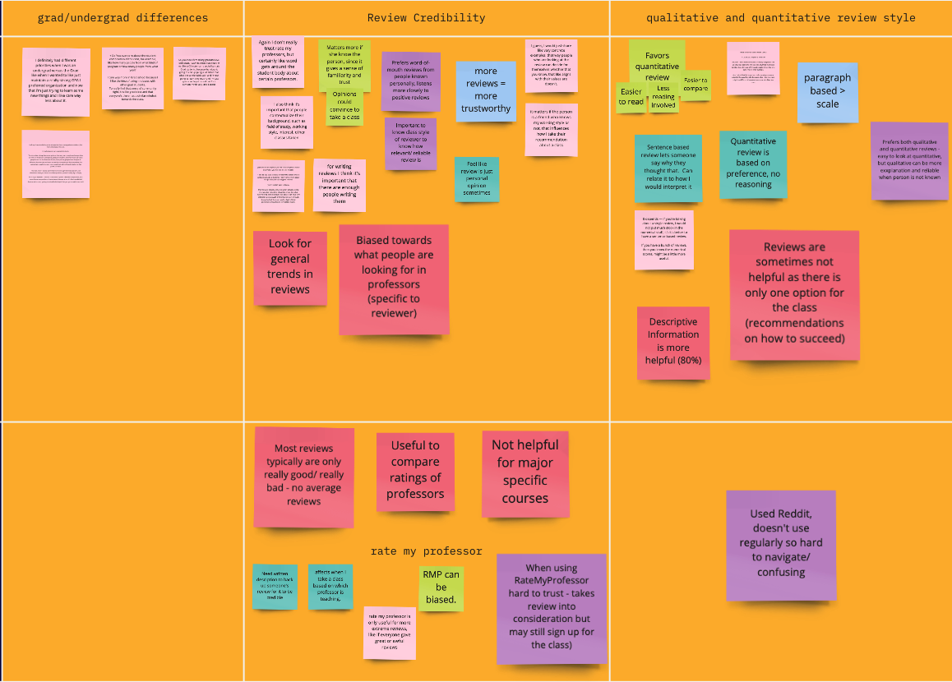
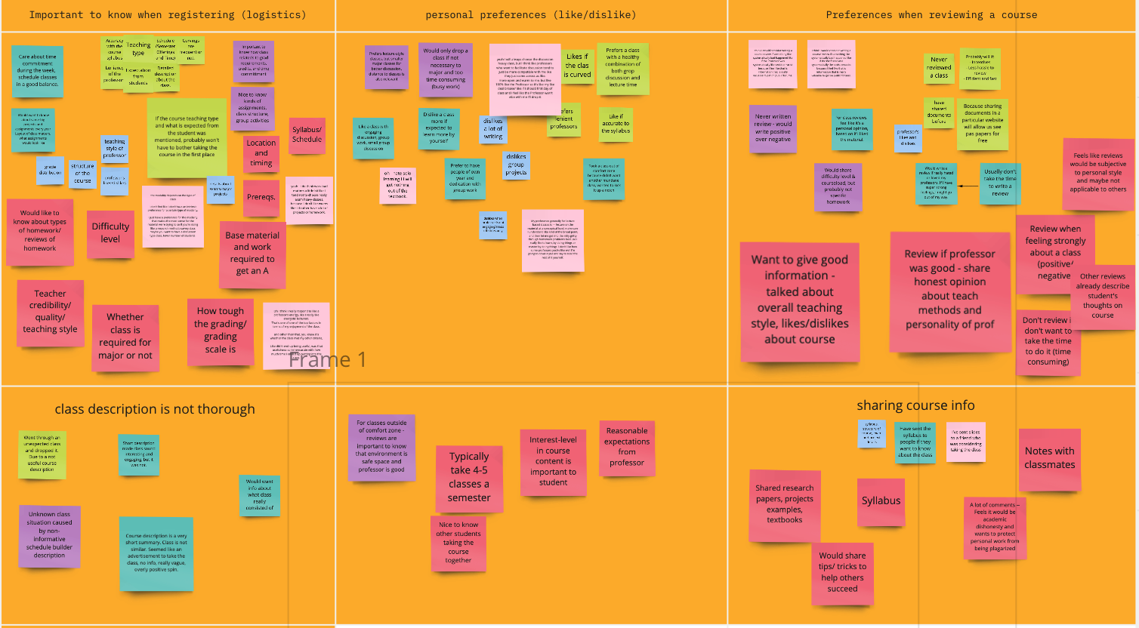
User Study Clusters
Analysis Process Steps
Notes:
Matt’s (30s)

Slide 6
Design Implications
Accommodate for subsets of individual differences in class considerations/preferences
Provide background information of students who are writing the review
Include and clarify the relationships between quantitative and qualitative parts of a review
Provide motivators for writing reviews
Notes:
(1.5mins)
Hazel

Slide 7
Ideation
Allow reviews to be filtered by feature
Suggestions for reviews : “comment on professor’s teaching style”, workload?, how to succeed, etc.
Option for liking/disliking reviews
Option for commenting on reviews
Provide a way to share documents
Way to ask professor about what you can share
Section for sharing tips or tricks about classes
Information on grade received in course of the reviewer
To start using the app, someone has to submit 2 reviews (unless first year or transfer)
Ability to make profiles
Background on learning style, major, etc.
Show the date of review
Main statistics at top of app homepage
Average rating shown next to name of class
Average grade received in class near the top
People can check off on their profile what “class features” they’re interested in
Tags or categories visualized at the top of the review
Indicator to show statistical strength of quantitative ratings (e.g. red if very few reviewers, green if more reviewers)
Require include instructor of course in review
Awards for achieving a certain number of likes on your review
Have people fill out background information about themselves when they make a profile
Background info on a person working style
Different color themes for the app
Being able to see more information if you are a review writer
Sorting reviews by department on home part of interface
Sorting reviews by class level (undergrad, graduate)
Sorting reviews by program requirements/liberal education requirements
Sorting reviews by average rating
Put a link to ScheduleBuilder for the course
Let people create schedules on the app
Let people save classes to their own thing
Allow people to rate difficulty level on the review
Visualize background information on the review
Reviewers should explain why they took a class
Make certain fields optional on a review to make writing easier
Certain descriptive fields are still required so there are words in the review
Link to Reddit for class info
Link to rate my professor for class info
Review can include student’s impression of class composition, especially for grad students
Indicator on the class and review to show what semesters the class is offered
Enable friending between user profiles
Include icons for different areas of study (e.g. STEM)
Allow people to make profile pictures
Q&A platform for asking questions about classes
Allow people to follow certain reviewers
There is a way to contact a reviewer to ask about their review (e.g. DMing)
Make awarded reviewers visibly indicated on the review
Put most-liked reviews at the top
Sort reviews for a class by certain criteria
People can use their rewards to buy stuff
Users get awards for writing a lot of reviews
Indication of average GPA of the reviewer on the reviewer (if they want to show it)
People can say in the review what grade they got in a class
Rating a review by different characteristics
You can upvote or downvote comments on a review
People can say how much time they spent on a class per week in the review
Option to share the review with a link
Bookmark, star, or save reviews
Organize saved reviews by self-defined categories
Highlighting on home page the classes with the most reviews
Highlighting most-liked classes in a section/list
Highlighting most-disliked classes in a section/list
Send reviews to other people in the app
Include courses you’ve taken on the student’s background profile
Including on profile what you care most about getting out of a class (e.g. grade, interest)
Include attach feature in DMS to enable attaching syllabus/documents
Quote of the day from a review can be highlighted on homepage or profile
Suggest friends on the app to users who have similar/overlapping background profiles
Suggest friends to people who have written reviews for the same class
Include summary of class from ScheduleBuilder (official school course description)
Sharing hobbies/interests on profile
Recommend a class to friends or followers
You can only make friends on the app if you write reviews
Certain features become unlocked if you write more reviews
Unlocked features can contain customizing profile
Can send virtual presents to reviewers that you like
Top reviewers get presents
Allow the option to review as a guest user
For guest reviews make sure to display lack of information saliently
If reading reviews as a guest you can only see certain features
Highlighted classes are only available to those who have profiles
Let professors to make profiles on the app
Professors can respond to reviews or comments for the class
Professors can post syllabus to the class
Verify professors on professor profile
Allow student users to be anonymous
Create username to remain anon while giving background information
Users can filter who can see their background info, including for professors
Verify user identity using real info but don’t display this in the app
Encourage or prompt people who write more concrete reviews
Provide questions for reviewers when they don’t know what to write
Have a mod for the board to manage potentially inappropriate information
Be able to ban reviewers
Disable mentioning students of classes by name in the review
Give warnings to people who wrote inappropriate reviews and let them see this on their profile
Send notifications at the end of classes to remind/prompt users to write reviews
Send notifications shortly before the registration period to remind/encourage users to check out reviews
Allow livestreaming to answer questions or talk about a class live
Clubhouse audio -- interactive podcast thing for anonymous discussion of a class
Top reviewers are nominated to become potential moderators for the review platform
Notes:
kimneyHazel

Slide 8
Idea Clusters
Allowing diverse profiles
Student
Guest - limited features, ability to use without creating a profile
Professor - respond to reviews & comments
Anonymous - ability to filter background info
Mod - moderate board and manage posts
Creating user profiles to create background information
Learning style, major, working style, interests, previous courses
Profile pictures
Visualizing crowdsourced course review information in a homepage summary
Highlight popular reviews, classes
Average class rating, average grade
Commonly searched tags or categories
Encourage (reward) users to write reviews
Awards for popular reviews
More features available for reviewers
Users socially share and network with each other about class
Friending & messaging between users
Q&A platform
Enable interaction with reviews
Liking/ Disliking reviews & comments
Ability to create schedules and bookmark classes
Require specific types of information to be mentioned in reviews
Include: instructor, class composition, grade, reason for taking
Some fields optional
Provide questions/ suggestions for reviewers
Notifications to remind key times for reviewing and reading
Reminders at end of semesters to prompt reviews to be written
Reminders before registration to prompt reviews to be read
Links to external resources (Reddit, RateMyProf, ScheduleBuilder)
Notes:
(1 min)
Nicole

Slide 9
Final Design Ideas
Allow users to create diverse profiles with individualized information
Accommodate different types of reviewers (registered, guest, professor, mod)
Provide reviewer background of working style, major, and interests
Create a homepage summary of review trends
Highlight most-liked, most-reviewed classes in a ranked list
Show average ratings and class grades along with statistical strength
Reward users for writing reviews
Visible awards for writing reviews with more likes, or for writing more reviews
Show average ratings and class grades along with statistical strength
Require reviews to contain specific, concrete information
Accommodate different types of reviewers (registered, guest, professor, mod)
Provide reviewer background of working style, major, and interests
Enable user interaction with reviews
Users can upvote/downvote reviews, or comment to provide more information
Professors with profiles can comment on reviews to clarify (reviewers remain anonymous)
Notes:
(2 min) Seraphina
How each of these tie back into design implications:
Users creating diverse profiles:
Accommodate for subsets of individual preferences about classes, because it makes it easier for students to understand other students’ backgrounds
Helps motivate students to write reviews since they don’t necessarily have to formally register to write one, just that the review would show that there’s no background information for this reviewer
Summary of review trends
Helps clarify the value of quantitative and qualitative review data
Reward users for writing reviews
Provides motivation for writing reviews
Concrete review information
Address individual differences in class considerations
Enable user interaction with reviews
Goes back to the design implications of providing more diverse backgrounds and experiences to better contextualize the review

Slide 10
Thanks for listening!

